Slide 1
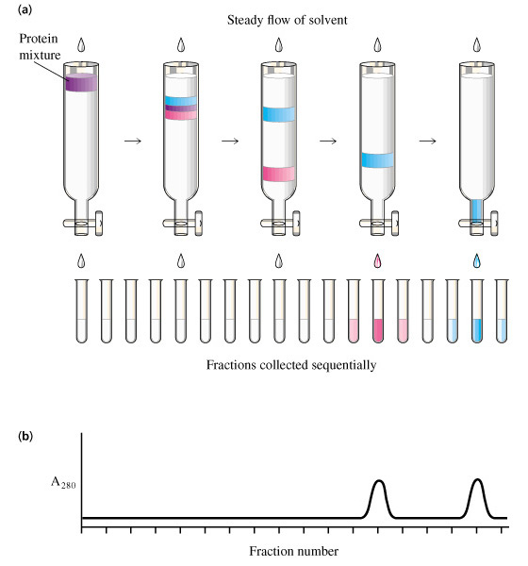

Slide 2
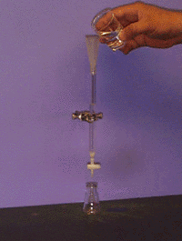
C
R
O
M
A
T
O
G
R
A
P
H
Y
A
N
I
MA
T
ION

Slide 3
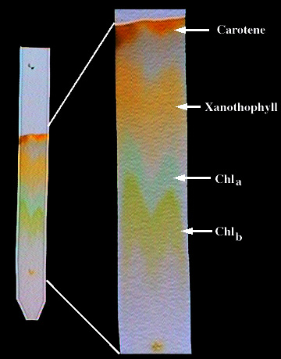
While chlorophyll is the chief pigment responsible for photosynthesis in green plants, many plants contain other coloured pigments as well. These chlorophyll and coloured pigments may be separated according to their various chemical charges by a technique known as chromatography.

Slide 4
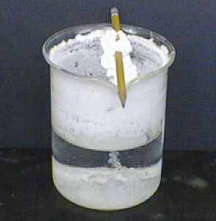

Slide 5
